Slide 1
Event Driven Architecture
Notes:
Not an expert
High level overview, enough for you get more info on your own
Considered a form or implementation of SOA
Can also be applied within an application, either in process or asycny
Why are You hear?
Are you using Messaging technologies?

Slide 2
Overview
Terms & Concepts
Advantages and Disadvantages
Message Patterns
Domain Events
CQRS
Notes:
----- Meeting Notes (3/2/11 16:22) -----

Slide 3
Applications Respond to External Stimuli
Most applications try to model things that happen
An Order Is Received
A package arrives at a destination
An airplane takes off (and hopefully lands)
A car passes a toll booth
Notes:
Designing your application around the events it responds too, gets it closer to the reality and easier to model and adapt

Slide 4
Two Types of Messages
An event is an action that has occurred
A command is an action you want to occur
Notes:
Something of interest occurred either internal or external to the system

Slide 5
Message Channel
A message channel defines where a message is sent and who is listening is for the message
Notes:
This could be a queue setup in MSMQ
A table in a
Defining multiple channels is a way to increase throughput

Slide 6
Event Processor
The event processor invokes all of the registered event consumers for a specfic message
Notes:
Event Aggregation
This could be in process, or distributed using various technologies, msmq, database tables, whatever
Has transaction responsibility
Event Consumers can either be explicitly or implicitly defined for a message

Slide 7
Message Bus
The message bus delivers the message to all interested parties
Publisher
Consumer
Bus
Consumer
Publisher
Notes:
Does not apply in routing logic other than finding the endpoints for a message

Slide 8
Message Broker
Messages come into the broker
Rules and Transformations applied
Messaged directed to specific end points
Notes:
Can be a single point of failure
Requires the fork lift upgrade

Slide 9
Anti Pattern
Monolith Application
One System to rule them all
System
Inventory
Accounting
Marketing
Shipping
Sales
Notes:
Monolithic Domain has
There is only one representation of an Order used by all users
Unintended consequences
Single Database / Single point of failure / bottleneck
Reporting stops warehouse

Slide 10
Bounded Context
Notes:
Domain objects mean different things for different users, an order means something different in the Accounting Dept than it does in the Shipping Dept.
Each context can change as needed without affecting the other components

Slide 11
Loosely Connected System
Shared Kernel
Sales
Inventory
Shipping
Accounting
Marketing
Notes:
Shared Kernel is the messages sent
Each can have their own representation of an order
Each is the system of record for their domain and have cached, readonly data from other systems updated by messages
These are coursely defined. You can have a much finer grain separation that gives you more flexibility

Slide 12
Eventual Consistency

Slide 13
Your Data is already Stale!

Slide 14
Business Decisions are Made On Stale Data
Notes:
User runs a report, exports to excel, slices dices
By 4:00 has an epiphany and emails the results
His epiphany is then read the next day after reading the 200 other emails in the inbox

Slide 15
Make Consistency Explicit

Slide 16
Advantages

Slide 17
Scalability is a Side Effect

Slide 18
Reduces Coupling
Handlers Loosely Coupled to Publishers
Spatial Coupling
Temporal Coupling
Notes:
Spatial where services are located
Temporal time it takes to perform an operation

Slide 19
Open Closed Principle

Slide 20
Single Responsibility Principle
Notes:
Eliminates need to Service Objects

Slide 21
Disadvantages

Slide 22
Learning Curve

Slide 23
Complexity is the Same, just moved

Slide 24
Deployments

Slide 25
Operations need to be on board

Slide 26
Domain Events
Allows domain object to encapsulate state consistency
Keeps dependencies out of domain objects
Notes:
A way to separate out functionality that would normally be in a service layer

Slide 27
CQRS
Separate Persistence for reads and writes

Slide 28
Basic Architecture
Create a Command
Validate the Command from ViewModel
Send the Command
Command Handler gets the domain object and calls a method on the object to process it
Domain object ensures the state of the object is not is still valid
Publishes an Event
View Model Event Handlers update denormalized views with change
Notes:
Send has different semantics than publish
Command can fail
Events cannot

Slide 29
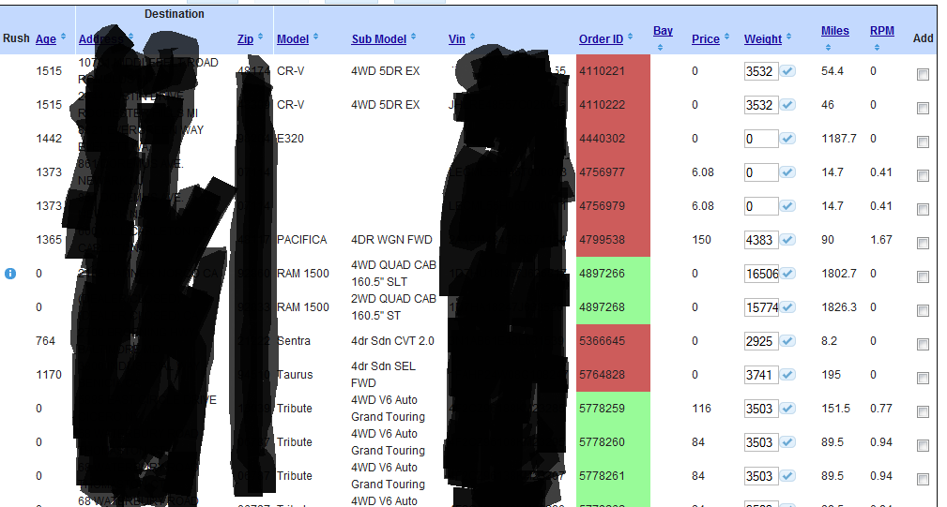
A Complicated View

Slide 30
SQL to Generate View
WITH LoadBuilderData AS
(
select
count(*) over() as totalcount,
Row_Number() over (order by Orders.OrderId) as RowNumber,
Orders.OrderId,
Orders.Price,
coalesce(dbo.RW_OrderAgeArrived(Orders.OrderId),0) as Age,
Convert(decimal(18,2),Round((coalesce(Orders.Price,0) / case Orders.Miles when 0 then 1 when null then 1 else Orders.Miles end),2)) as RPM,
Orders.Miles,
destination_address.Addr1 as DestinationAddress,
destination_address.city as DestinationCity,
destination_address.state as DestinationState,
destination_address.Zip as DestinationZip,
Vehicles.VehicleId,
Vehicles.Vin,
Vehicles.Model,
Vehicles.SubModel,
Vehicles.Bay,
Vehicles.[Weight],
shippers.shipperId,
shippers.ClientName,
carriers.ClientID as carrierid,
Orders.IsBrokered,
Orders.IsRushSold
from Orders
inner join vOrderVehicleCount
on Orders.OrderID = vOrderVehicleCount.OrderID and vOrderVehicleCount.NumberOfVehicles = 1
inner join OrderVehicles ov
on Orders.OrderID = ov.OrderID
inner join Vehicles
on Vehicles.VehicleID = ov.VehicleID
inner join ClientOrders destination_client_order
on destination_client_order.OrderId = Orders.OrderId and destination_client_order.[Type] = 'Destination'
inner join Clients destination
on destination.ClientID = destination_client_order.ClientID
inner join ClientAddresses destination_address
on destination_address.ClientId = destination_client_order.ClientId and destination_address.AddressType = 'Primary'
inner join ClientOrders origin_client_order
on origin_client_order.OrderId = Orders.OrderId and origin_client_order.[Type] = 'Origin'
inner join Clients origin
on origin.ClientID = origin_client_order.ClientID
inner join ClientAddresses origin_address
on origin_address.ClientId = origin_client_order.ClientId and origin_address.AddressType = 'Primary'
inner join vOrderShippers shippers
on Orders.OrderId = shippers.OrderID
left outer join ClientOrders carriers
on Orders.OrderId = carriers.OrderId and carriers.type = 'Carrier'
where 1=1 and Orders.Status in ('Active','PendingPickup') and Orders.OrderType in ('Individual','LegChild'))
select *
FROM LoadBuilderData
WHERE RowNumber BETWEEN 0 AND 50 ORDER BY RowNumber ASC

Slide 31
CQRS View Query
Select * from LoadBuilderView where …

